Slide 1

DATA STRUCTURES
UNIT-3
Part 1: Stacks
Dr. Nagarathna N
PROFESSOR
B.M.S. COLLEGE OF ENGINEERING

Slide 2
UNIT 3
Stacks: Operations, array representations of stacks, stack applications - infix to postfix conversion, postfix expression evaluation, and function call tracing, recursion.
Queues: Introduction, Basic concept, linear queue operations, circular queue, priority queues, double ended queues. Applications of Queues.
Stack and queue implementation using linked lists

Slide 3


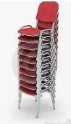
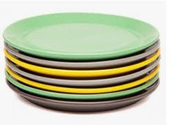
Stack: Representation of stacks in C
A stack is an Abstract Data Type (ADT), commonly used in most programming languages. It is named stack as it behaves like a real-world stack.
A real-world stack allows operations at one end only. Stack ADT allows all data operations at one end only. At any given time, we can only access the top element of a stack.
This feature makes it LIFO data structure. LIFO stands for Last-in-first- out. Here, the element which is placed (inserted or added) last, is accessed first.

Slide 4
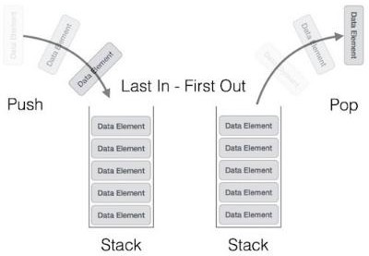
Stack Operations
Basic operations:
push() − Pushing (storing) an element on the stack.
pop() − Removing (accessing) an element from the stack.

Slide 5
Stack Operations
To use a stack efficiently, we need to check the status of stack as well. For the same purpose, the following functionality is added to stacks:
top() − get the top data element of the stack, without removing it.
isFull() − check if stack is full.
isEmpty() − check if stack is empty.

Slide 6
Operations on Stack
The following are some common operations implemented on the stack:
push(): When we insert an element in a stack then the operation is known as a push. If the stack is full then the overflow condition occurs.
pop(): When we delete an element from the stack, the operation is known as a pop. If the stack is empty means that no element exists in the stack, this state is known as an underflow state.
isEmpty(): It determines whether the stack is empty or not.
isFull(): It determines whether the stack is full or not.'
peek(): It returns the element at the given position.
count(): It returns the total number of elements available in a stack.
display(): It prints all the elements available in the stack.
Stack uses pointers that always point to the topmost element within the stack, hence called as the top pointer.

Slide 7
Applications
Function calls/Recursion
Undo operations/Editors
Balanced parentheses/ compiler
Backtracking

Slide 8
Implementation of Stack
Implementation of a stack using:
Arrays
Linked List

Slide 9
Insertion: PUSH
1. Checks if the stack is full.
2. If the stack is full, produces an error and exit.
3. If the stack is not full, increments top to point next
empty space.
4. Adds data element to the stack location, where top
is pointing.
5. Returns success.

Slide 10
Insertion: PUSH
#include <stdio.h>
int MAXSIZE = 8;
int stack[8];
int top = -1;
/* Check if the stack is full*/
int isfull()
{ if(top == MAXSIZE-1)
return 1;
else
return 0;
}
/* Function to insert into the stack */
int push(int data)
{
if(!isfull())
{ top = top + 1;
stack[top] = data;
}
else {
printf("Could not insert data, Stack is full.\n");
}
}

Slide 11
Insertion: PUSH
/* Main function */
int main(){
int i;
push(44);
push(10);
push(62);
push(123);
push(15);
printf("Stack Elements: \n");
// print stack data
for(i = 0; i < 8; i++)
{
printf("%d ", stack[i]);
}
return 0;
}

Slide 12
Deletion: POP
1. Checks if the stack is empty.
2. If the stack is empty, produces an error and exit.
3. If the stack is not empty, accesses the data element at
which top is pointing.
4. Decreases the value of top by 1.
5. Returns success.

Slide 13
Deletion: POP
#include <stdio.h>
int MAXSIZE = 8;
int stack[8];
int top = -1;
/* Check if the stack is empty */
int isempty(){
if(top == -1)
return 1;
else
return 0;
}
/* Check if the stack is full*/
int isfull(){
if(top == MAXSIZE-1)
return 1;
else
return 0;
}

Slide 14
Deletion: POP
/* Function to delete from the stack */
int pop(){
int data;
if(!isempty())
{data = stack[top];
top = top - 1;
return data; }
else {
printf("Could not retrieve data, Stack is empty.\n");
}
}
/* Function to insert into the stack */
int push(int data){
if(!isfull()) {
top = top + 1;
stack[top] = data;
} else {
printf("Could not insert data, Stack is full.\n");
}
}

Slide 15
Deletion: POP
/* Main function */
int main(){
int i;
push(44);
push(10);
push(62);
push(123);
push(15);
printf("Stack Elements: \n");
// print stack data
for(i = 0; i < 8; i++) {
printf("%d ", stack[i]);
}
printf("\nElements popped: \n");
// print stack data
while(!isempty()) {
int data = pop();
printf("%d ",data);
}
return 0;}

Slide 16
Deletion: POP
/* Main function */
int main(){
int i;
push(44);
push(10);
push(62);
push(123);
push(15);
printf("Stack Elements: \n");
// print stack data
for(i = 0; i < 8; i++) {
printf("%d ", stack[i]);
}
/*printf("Element at top of the stack: %d\n" ,peek());*/
printf("\nElements popped: \n");
// print stack data
while(!isempty()) {
int data = pop();
printf("%d ",data);
}
return 0;}

Slide 17
Stack FULL
1.START
2. If the size of the stack is equal to the top position of the stack,
the stack is full. Return 1.
3. Otherwise, return 0.
4. END

Slide 18
Stack FULL
#include <stdio.h>
int MAXSIZE = 8;
int stack[8];
int top = -1;
/* Check if the stack is full */
int isfull(){
if(top == MAXSIZE)
return 1;
else
return 0;
}
/* Main function */
int main(){
printf("Stack full: %s\n" , isfull()?"true":"false");
return 0;
}

Slide 19
Stack EMPTY
1. START
2. If the top value is -1, the stack is empty. Return 1.
3. Otherwise, return 0.
4. END
int isempty()
{
if(top == -1)
return 1;
else
return 0;
}

Slide 20




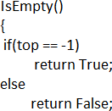
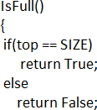
Array Implementation
Pseudo code:

Slide 21
Lab Program 5
Write a program to simulate the working of stack using an array with the following:
Push
Pop
Display
The program should print appropriate messages for stack overflow, stack underflow.

Slide 22
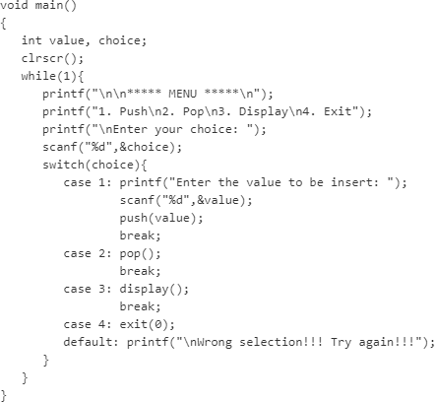
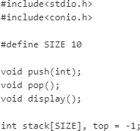
Array Implementation

Slide 23
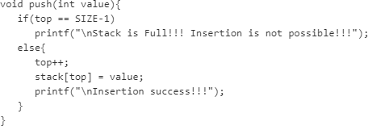
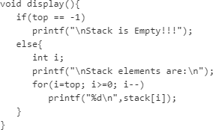
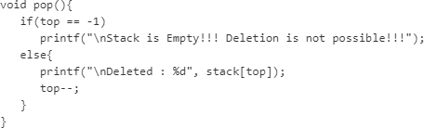
Array Implementation

Slide 24
Linked List Implementation

Slide 25
Check for balanced parentheses
(a+b)
(a+b)*(c-d)
{(a+b)*(c-d)}
[(a+b)*(c-d)
(a+b)*(c-d)]
(a+b}
Notes:
Counting opening and closing won’t work as the may be out of order. Eg ) ( or { ( } )
Last unclosed should be closed first.

Slide 26
Check for balanced parentheses
The idea is to put all the opening brackets in the stack.
Whenever you hit a closing bracket, search if the top of the stack is the opening bracket of the same nature.
If this holds then pop the stack and continue the iteration.
In the end if the stack is empty, it means all brackets are balanced or well-formed.
Otherwise, they are not balanced.
Follow the steps mentioned below to implement the idea:
Declare a character stack.
Now traverse the string exp.
If the current character is a starting bracket ( ‘(‘ or ‘{‘ or ‘[‘ ) then push it to stack.
If the current character is a closing bracket ( ‘)’ or ‘}’ or ‘]’ ) then pop from the stack and if the popped character is the matching starting bracket then fine.
Else brackets are Not Balanced.
After complete traversal, if some starting brackets are left in the stack then the expression is Not balanced, else Balanced.

Slide 27
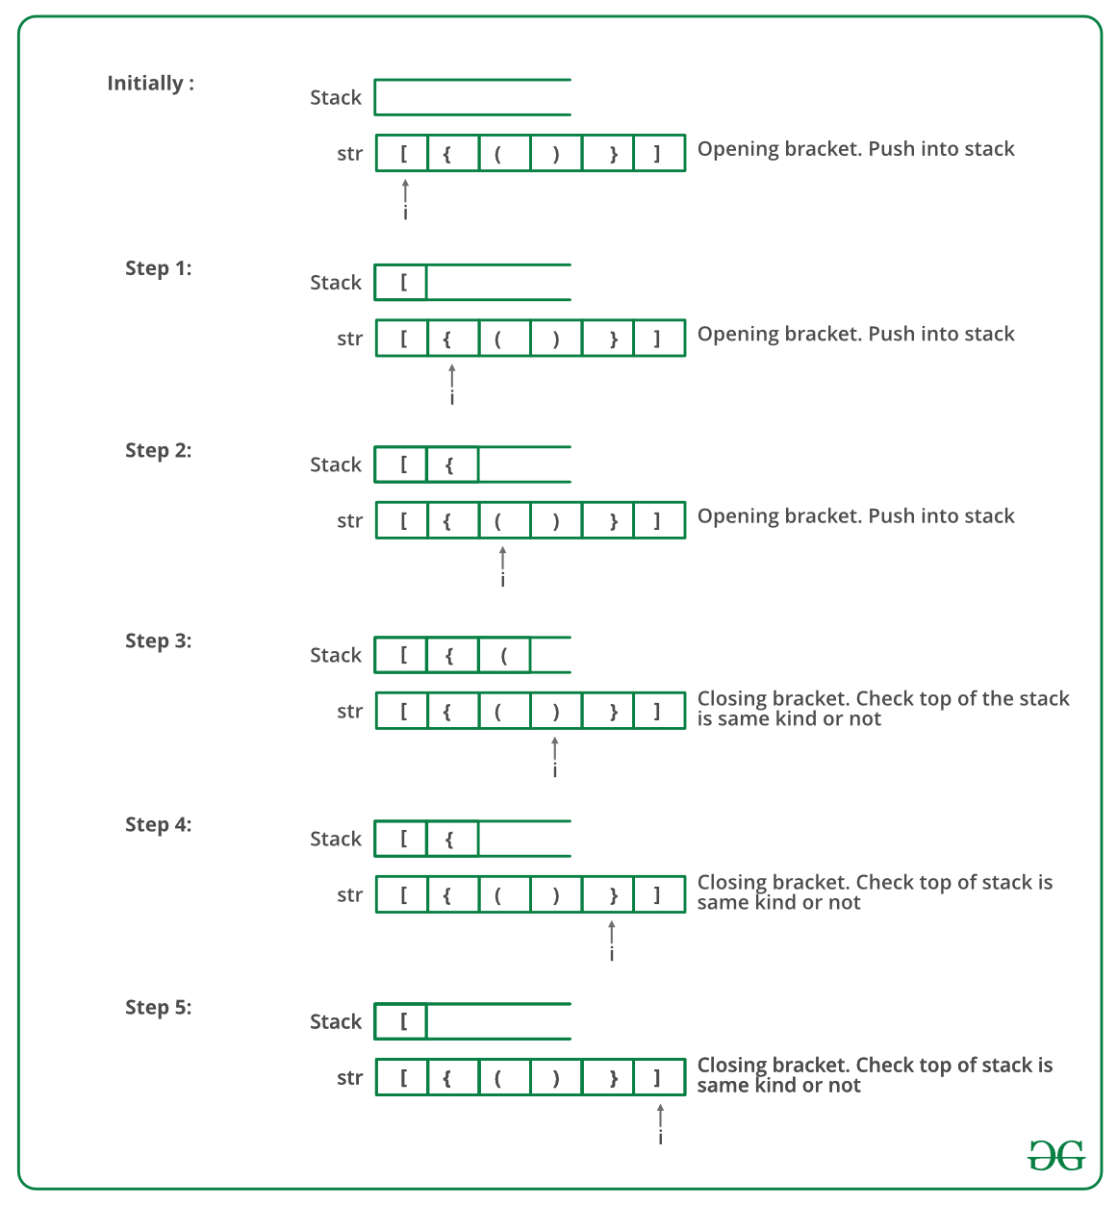
Check for balanced parentheses

Slide 28
Check for balanced parentheses
for i=0 to n-1
{ if exp[i] is ‘(‘ or ‘{‘ or ‘[‘ PUSH(exp[i])
else if exp[i] is ‘)‘ or ‘}‘ or ‘]‘
{ if (stack is empty OR top of stack does not match with exp[i])
print “UNBALANCED”
else pop()
}
}
return Is stack empty? True / False
Notes:
Counting opening and closing won’t work as the may be out of order. Eg ) ( or { ( } )
Last unclosed should be closed first.

Slide 29
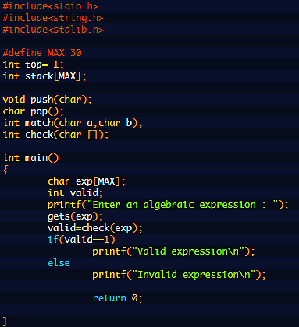
Check for balanced parentheses

Slide 30
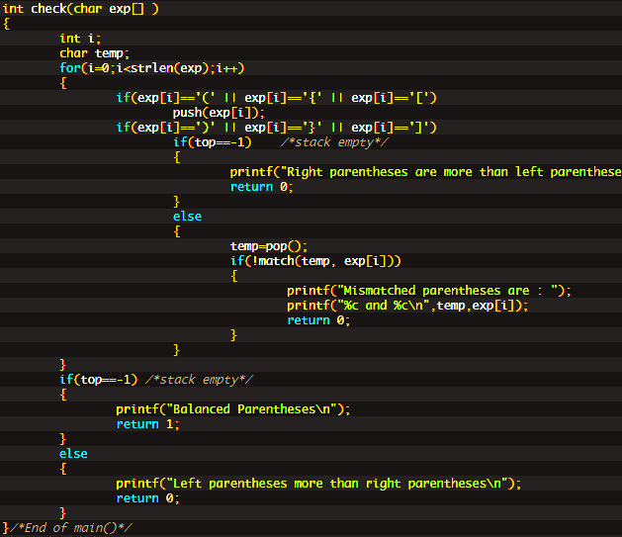

Slide 31
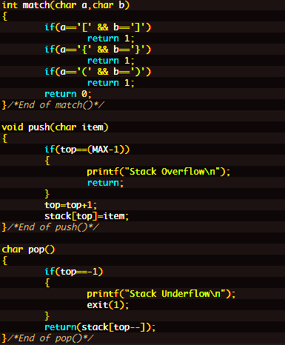

Slide 32
Check for balanced parentheses
for i=0 to n-1
{ if exp[i] is ‘(‘ or ‘{‘ or ‘[‘ PUSH(exp[i])
else if exp[i] is ‘)‘ or ‘}‘ or ‘]‘
{ if (stack is empty OR top of stack does not balance with exp[i])
print “UNBALANCED”
else pop()
}
}
return Is stack empty? True / False
Notes:
Counting opening and closing won’t work as the may be out of order. Eg ) ( or { ( } )
Last unclosed should be closed first.

Slide 33
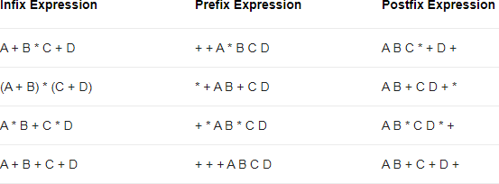
Infix, Prefix and Postfix
Infix, Postfix and Prefix notations are three different but equivalent ways of writing expressions.

Slide 34
Precedence and Associativity
Parenthesis : () {} []
Exponents ^ : Right to Left Associativity
* and / : Left to Right Associativity
+ and - : Left to Right Associativity

Slide 35
Infix, Prefix and Postfix
Infix, Postfix and Prefix notations are three different but equivalent ways of writing expressions.
Infix Notation:
<operand> <operator> <operand>
Prefix Notation (Polish notation):
<operator> <operand> <operand>
Postfix Notation (Reverse Polish notation):
<operand> <operand> <operator>
Notes:
Insert all the implicit parenthesis based on precedence and the convert.

Slide 36
Advantage of Postfix Expression over Infix Expression
An infix expression is difficult for the machine to know and keep track of precedence of operators. Not easy to parse and evaluate an Infix expression without ambiguity. Eg. 2+4*6
On the other hand, a postfix expression itself determines the precedence of operators (as the placement of operators in a postfix expression depends upon its precedence). No need to take care of precedence and associativity.
Parenthesis free and can be parsed without ambiguity.
Therefore, for the machine it is easier to carry out a postfix expression than an infix expression.

Slide 37
Evaluate the postfix expression
Infix: { (2*3) + (4*5) } – 6
Postfix: ?

Slide 38
Evaluate the postfix expression
Infix: { (2*3) + (4*5) } – 6
Postfix: 2 3* 4 5* + 6 –

Slide 39
Evaluate the postfix expression
Postfix: 2 3* 4 5* + 6 –
Step1: 2 3* 4 5* + 6 –
6 4 5* + 6 –
Step2: 6 4 5* + 6 –
6 20 + 6 –
Step3: 6 20 + 6 –
26 6 –
Step4: 26 6 –
20

Slide 40
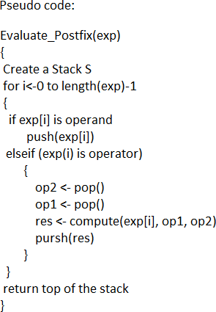
Evaluate the postfix expression

Slide 41
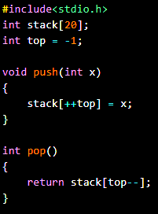
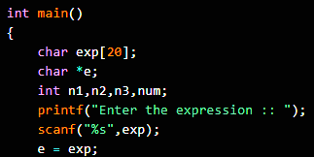
Postfix Evaluation

Slide 42
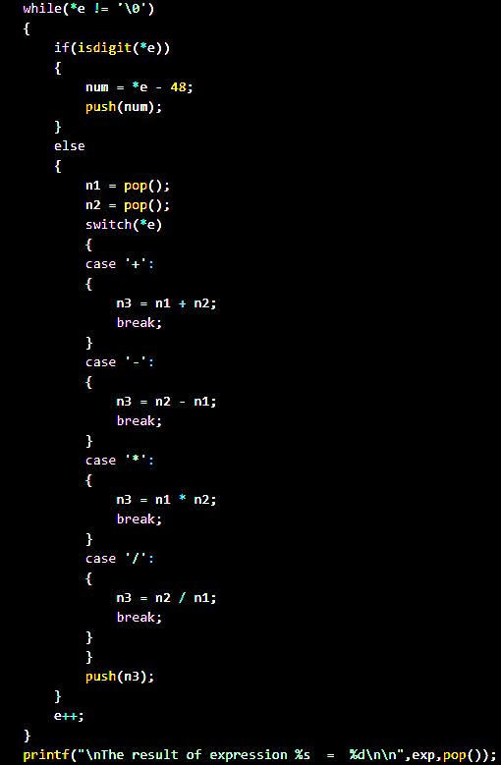
Postfix Evaluation
The isdigit() function is a predefined function of the C library, which is used to check whether the character is a numeric character from 0 to 9 or not.
Non-zero integer/True: Argument is a numeric character.
Zero(0)/False: Argument is not a numeric character.
It is defined in <ctype.h> header file.

Slide 43
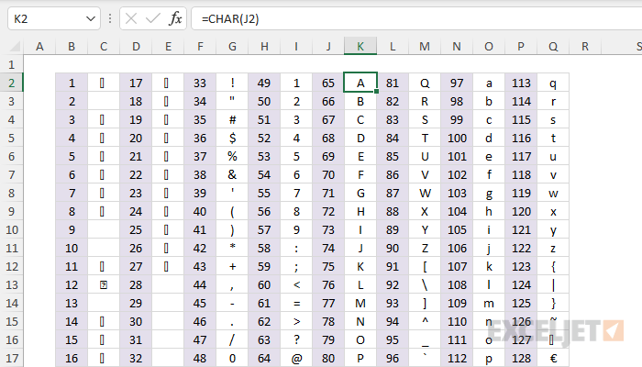

Slide 44
Example (Infix to Postfix)
Infix:
A*B+C*D-E AB*+C*D-E AB*+CD*-E AB*CD*+-E
•
•
•
Postfix:AB*CD*+E-
•

Slide 45
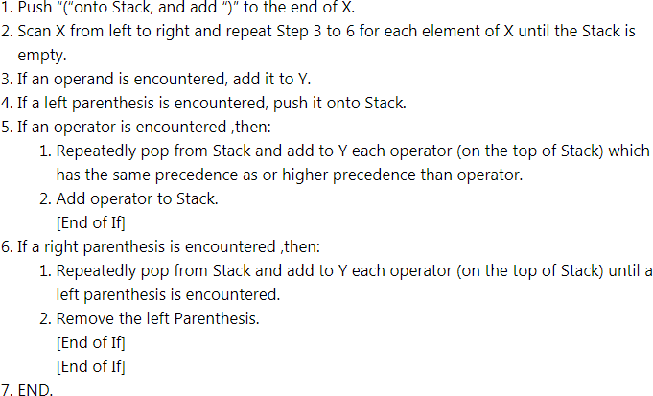
Algorithm Infix to Postfix

Slide 46
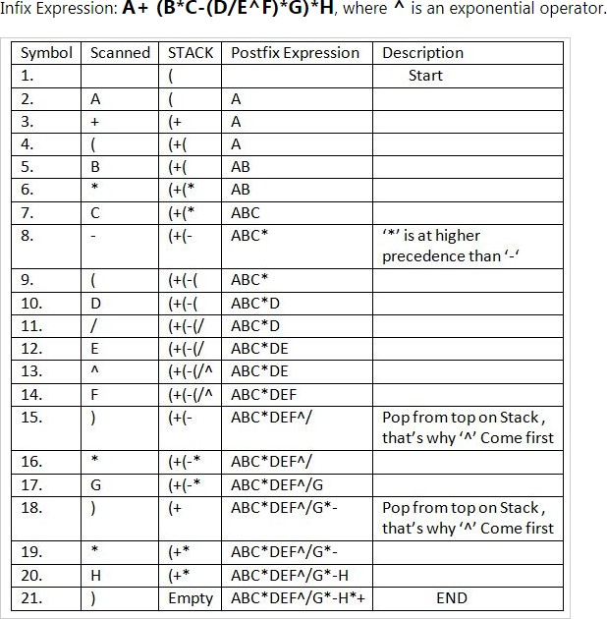

Slide 47
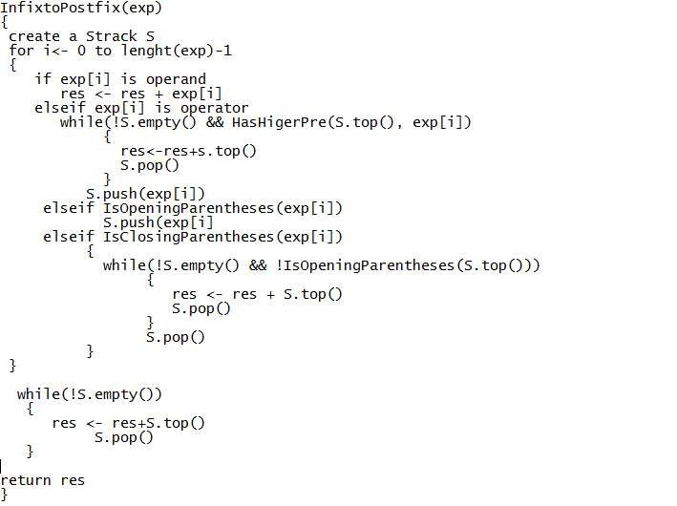
Infix to Postfix Pseudo code
•
•
•
•
•
•
•
•
•
•
•
•
•
•
•
•
•
•
•
•
•
•
•
•
•
•
InfixtoPostfix(exp)
{
create a Strack S
for i<- 0 to lenght(exp)-1
{
if exp[i] is operand
res <- res + exp[i] elseif exp[i] is operator
while(!S.empty() && HasHigerPre(S.top(), exp[i])
{
res<-res+s.top() S.pop()
}
S.push(exp[i])
elseif IsOpeningParentheses(exp[i]) S.push(exp[i]
elseif IsClosingParentheses(exp[i])
{
while(!S.empty() && !IsOpeningParentheses(S.top()) && HasHigerPre(S.top(), exp[i]))
{
res <- res + S.top() S.pop()
}
S.pop()
}
}
•
•
•
•
•
while(!S.empty())
{
res <- res+S.top() S.pop()
}
•
•
return res
}

Slide 48
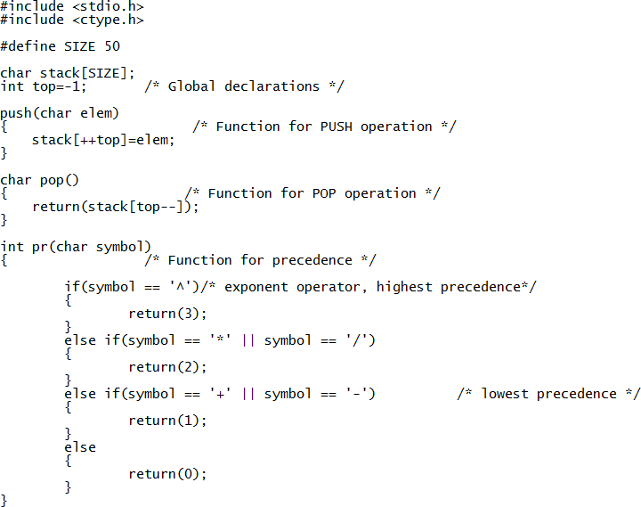
C Code

Slide 49
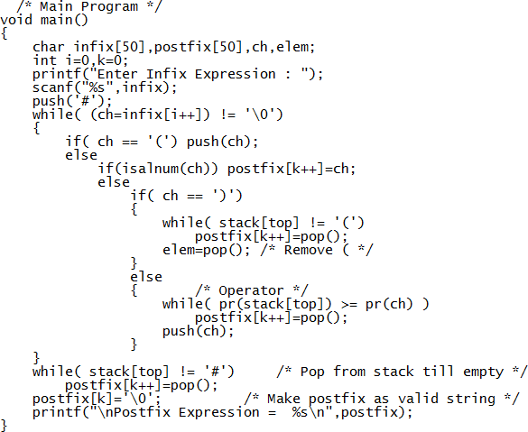

Slide 50
Infix to Prefix
Step 1: Add '')" to the end of the infix expression
Step 2: Push(onto the stack
Step 3: Repeat until each character in the infix notation is scanned
IF a(is encountered, push it on the stack
IF an operand (whether a digit or a character) is encountered, add it postfix expression.
IF a ")" is encountered, then
Repeatedly pop from stack and add it to the postfix expression until a "(" is encountered.
Discard the "(".That is, remove the(from stack and do not add it to the postfix expression
IF an operator O is encountered, then
Repeatedly pop from stack and add each operator ( popped from the stack) to the postfix expression which has the same precedence or a higher precedence than O
Push the operator to the stack
[END OF IF]
Step 4: Repeatedly pop from the stack and add it to the postfix expression until the stack is empty
Step 5: EXIT
Prefix
Step 1: Reverse the infix string. Note that while reversing the string you must interchange left and right parentheses.
Step 2: Obtain the postfix expression of the infix expression Step 1.
Step 3: Reverse the postfix expression to get the prefix expression

Slide 51
Lab Program #6
6. Write a program to convert a given valid parenthesized infix arithmetic expression to postfix expression. The expression consists of single character operands and the binary operators + (plus), - (minus), * (multiply) and / (divide).

Slide 52
Recursion
The process in which a function calls itself directly or indirectly is called recursion and the corresponding function is called as recursive function.
Using recursive algorithm, certain problems can be solved quite easily.
Examples of such problems are Towers of Hanoi (TOH), Inorder/Preorder/Postorder Tree Traversals, DFS of Graph, etc.

Slide 53
Types of Recursion
Direct recursion
Indirect recursion
Tail recursion
Head recursion

Slide 54
Recursive Stack
When a recursive function is invoked, its parameters are stored in a data structure called activation records.
Every time the recursive function is invoked, a new activation record is generated and stored in the memory.
These activation records are stored in the special stack called the recursive stack.
These activation records are deleted when the function execution is completed.

Slide 55
Example
void printFun(int test)
{
if (test < 1) return;
else {
printf(“%d”,test);
printFun(test - 1);
return;
}
}
int main()
{
int test = 3; printFun(test);
}

Slide 56
Example
void printFun(int test)
{
if (test < 1) return;
else {
printFun(test - 1);
printf(“%d”,test);
return;
}
}
int main()
{
int test = 3;
printFun(test);
}

Slide 57
Example
#include<stdio.h>
void printFun(int test)
{
if (test ==0) return;
else {
printf(“%d”, 2+printFun(test-2));
}
}
int main()
{
printf(“%d”, printFun(4));
return 0;
}

Slide 58
Example
#include<stdio.h>
void printFun(int test)
{
if (test>0) {
printf(“%d”, test)
printFun(test-1);
}
}
int main()
{
printFun(3);
}

Slide 59
Example
#include<stdio.h>
void printFun(int test)
{
if (test>0) {
printf(“%d”, test)
printFun(test-1);
printFun(test-1);
}
}
int main()
{
printFun(3);
}

Slide 60
Example
#include<stdio.h>
void printFun(int test)
{
if (test>0) {
printf(“%d”, test)
printFun(test-1);
printFun(test-1);
}
}
int main()
{
printFun(3);
}
3,2,1,1,2,1,1

Slide 61
Problem
For given an input of n integers write a recursive function that sums all the integers up to n.
Eg. 1+2+3+4+……+n
Base case is: if n=0 return 0

Slide 62
Problem
For given an input of n integers write a recursive function that sums all the integers up to n.
Eg. 1+2+3+4+……+n
Base case is: if n=0 return 0
sum(n) = 0 if n=0 return 0
n + sum(n-1) if n>0
int sum(n)
{ if (n==0) return 0;
else
return(n + sum(n-1));
}

Slide 63
Problem
For given an input of n integers write a recursive function that sums all the integers up to n.
Eg. 1+2+3+4+……+n
int sum(n)
{ if (n==0) return 0;
else
return(n + sum(n-1));
}
n=5
sum(5) sum(4) sum(3) sum(2) sum(1) sum(0)
5+10=15 4+6=10 3+3=6 2+1=3 1+ 0=1 0

Slide 64
Example: Find a Factorial of n
factorial of n (n!) = 1 * 2 * 3 * 4 *... * n

Slide 65
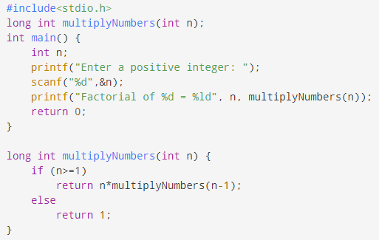
Example: Find a Factorial of n
factorial of n (n!) = 1 * 2 * 3 * 4 *... * n

Slide 66
Example: Fibonacci series
1 1 2 3 5 8 13 21 …. Fib(n) = Fib(n-1) + Fib(n-2)
#include<stdio.h>
int fib(int n)
{
if (n <= 1) // if(n==1 || n==2)
return n; // return 1
return fib(n-1) + fib(n-2);
}
int main ()
{
int n = 6;
printf("%d", fib(n));
getchar();
return 0;
}

Slide 67
Example: Indirect Recursion solve for n=10
func odd(int n) { if (n<=10) { printf("%d",n+1); n++; even(n); } return; } | func even(int n) { if (n<=10) { printf("%d",n-1); n++; odd(n); } return; }

Slide 68
Example: Indirect Recursion
Print odd number to n+1 and even number to n-1 (if n=1, print 2,1,4,3,6,5,8,7,10,9)
func odd(int n) { if (n<=10) { printf("%d",n+1); n++; even(n); } return; } | func even(int n) { if (n<=10) { printf("%d",n-1); n++; odd(n); } return; }

Slide 69
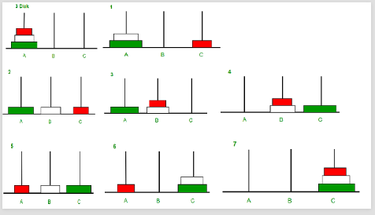
Example: Tower of Hanoi

Slide 70





If n=1
move disk from S to D n>1
S1:move(n-1) disks from S to A using D
S2: move disk from S to D
S3: move(n-1) disks from A to D using S
<-S1
<-S2
<-S3

Slide 71
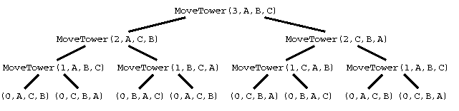
Towerofhanoi(n,s,a,d)
{
if(n==1)
{ print “S ->D” return;
}
Towerofhanoi(n-1,s,d,a) printf “S->D”
Towerofhanoi(n-1,a,s,d)
}
https://www.cs.cmu.edu/~cburch/survey/recurse/hanoiex.html

Slide 72
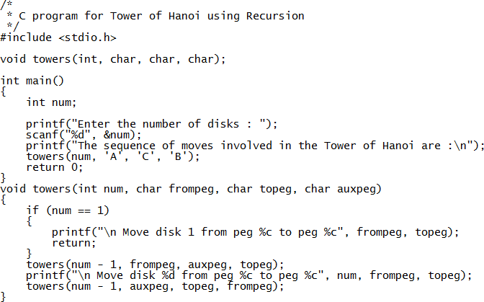

Slide 73
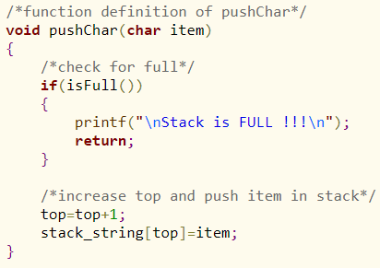


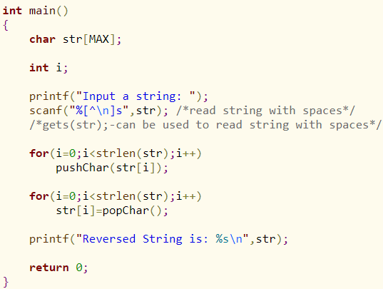
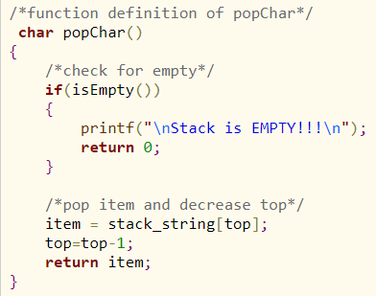
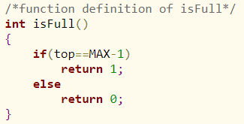
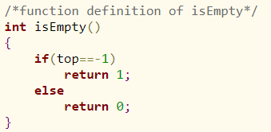
Stack Application: Reverse a string

